Slide 1

BUILDING BIODIVERSITY KNOWLEDGE
FROM THE GROUND UP
Tools and approaches at a local, regional and national level, applied in Kenya to document and understand Kenya’s biodiversity
David Western – Director, AMBOSELI CONSERVATION PROGRAM
Lucy Waruingi – Director, AFRICAN CONSERVATION CENTRE
African Conservation Centre
PO Box 15289-00509
Nairobi, KENYA
URL: www.conservationafrica.org
Email: lucy.waruingi@acc.or.ke

Slide 3
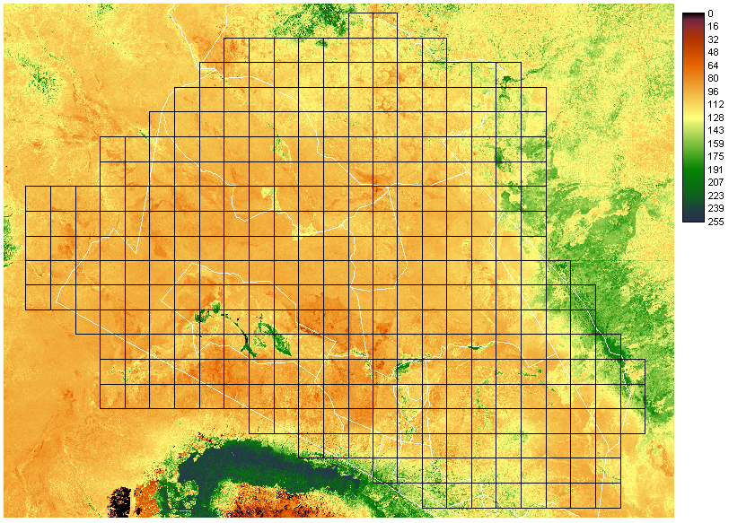
AMBOSELI NDVI

Slide 4
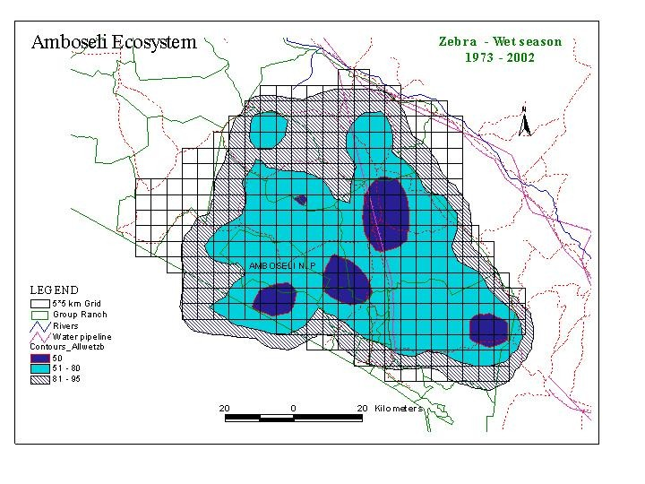
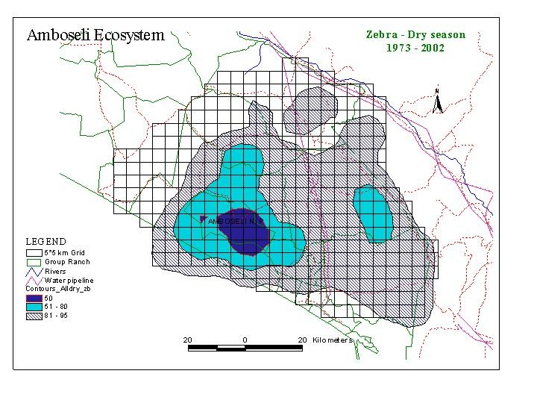
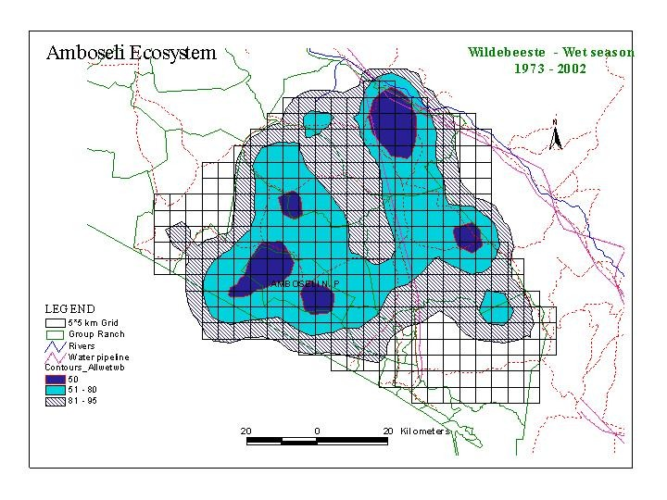
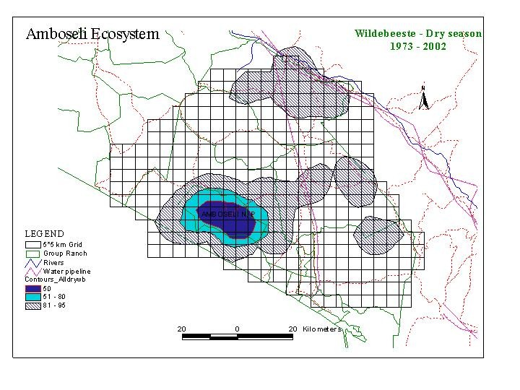

Slide 5
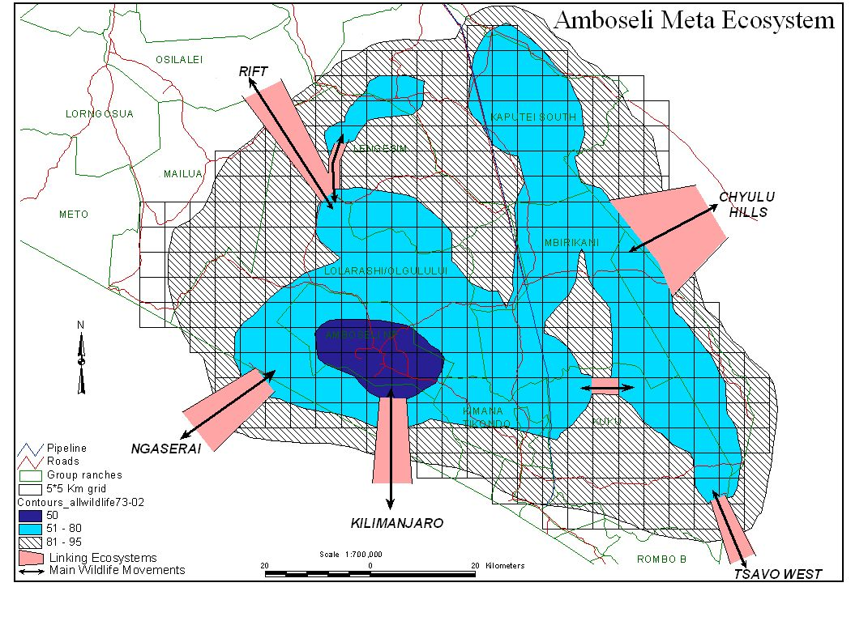

Slide 6
Wildlife without Elephant

Slide 7
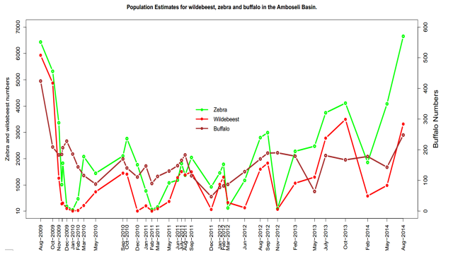

Slide 8
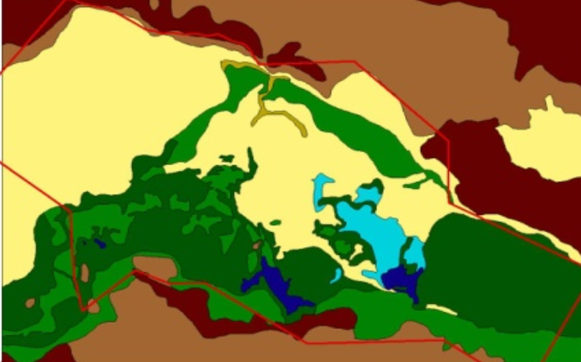
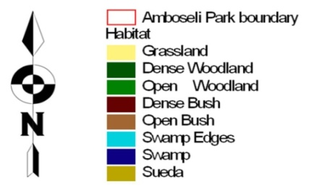
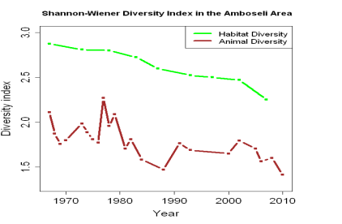
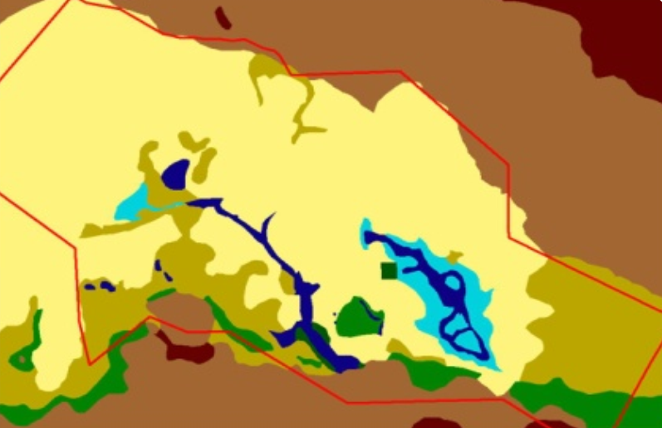
HABITAT CHANGE 1967 - 2007
Notes:
Plant community ….
Combined and interactive effects of water, protection, settlement, agriculture …
ecosystem level change – homogenization – eg. loss of key woodland habitats – decline in habitat diversity in the park, expansion of bush outside of park in absence of elephants, elimination of swamps outside of protected areas
within habitat change – structural and species homogenization (swamp exclosure vs grazed swamp – image, plot?)
productivity – cycles, biomass over time (bush and swamp as deviations from long term mean), spatial homogenization within habitats -biomass of different plots within habitats over time – is there more spatial variability early on? Temporal variability?

Slide 9
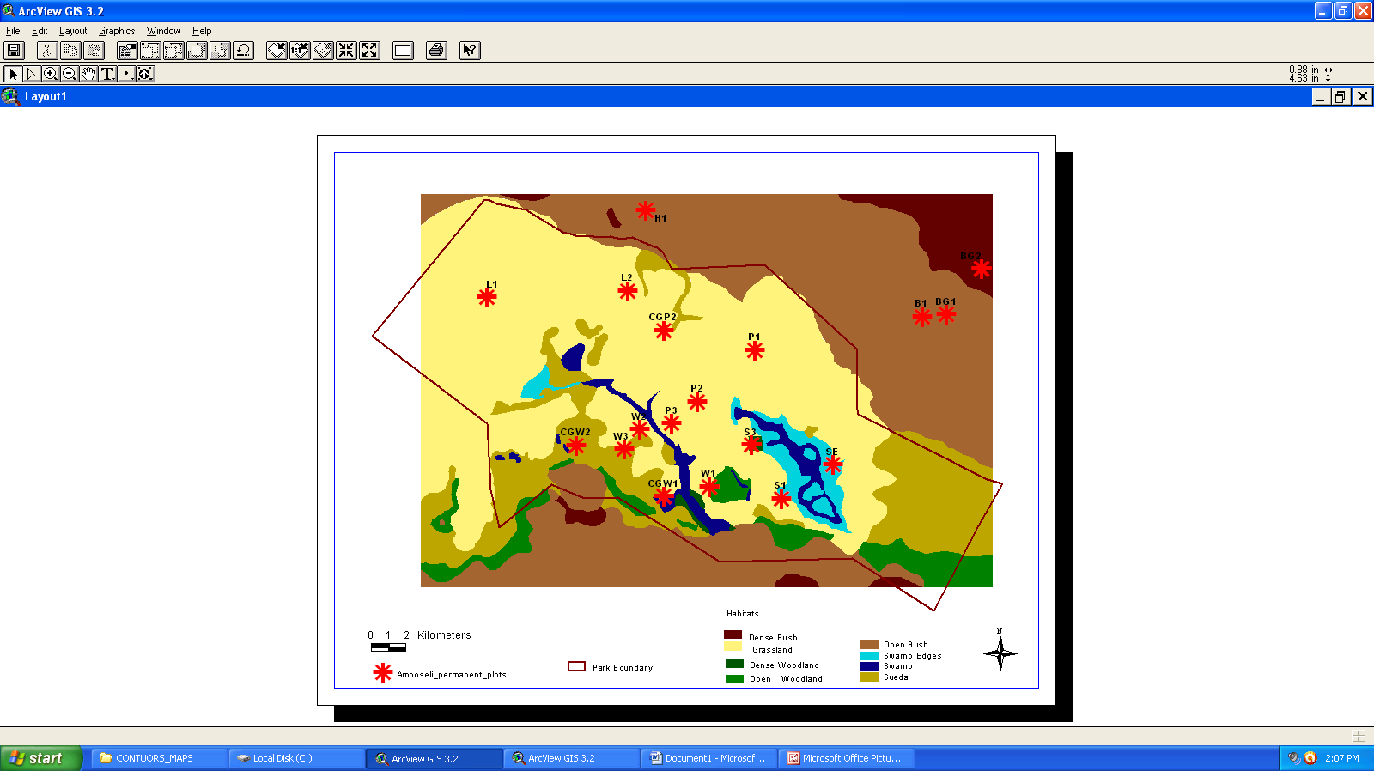

Slide 10
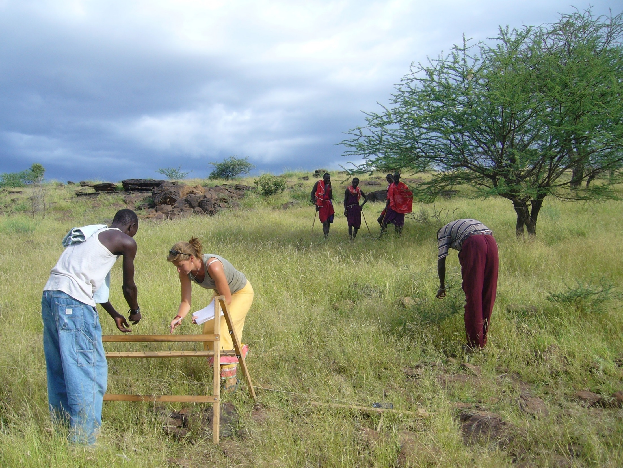

Slide 11
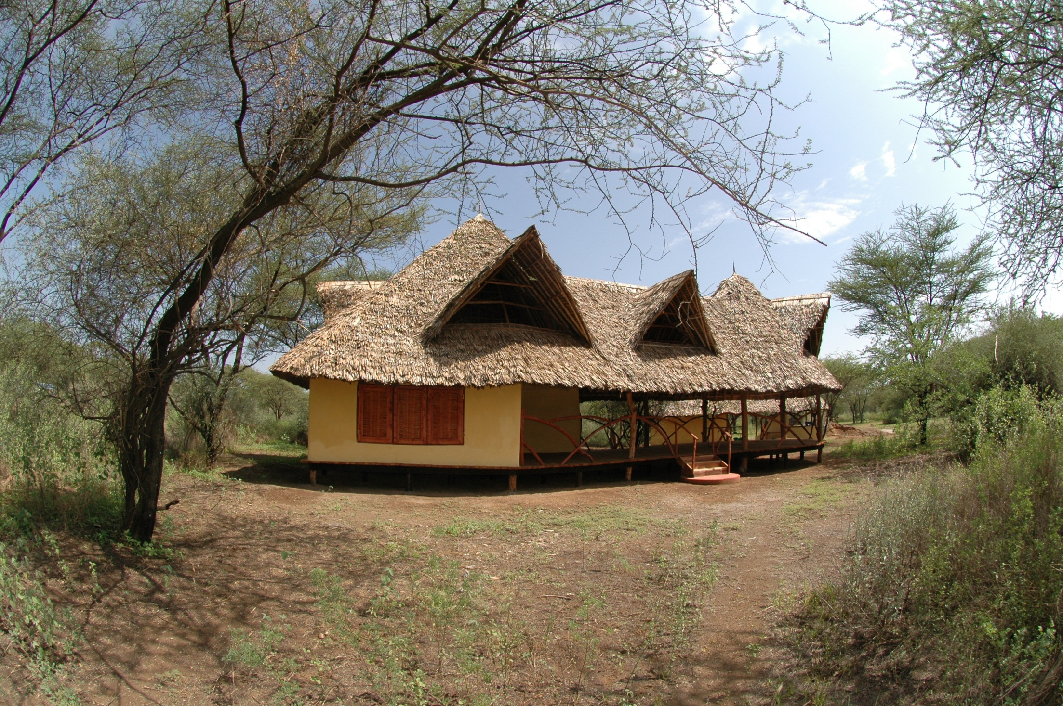

Slide 12
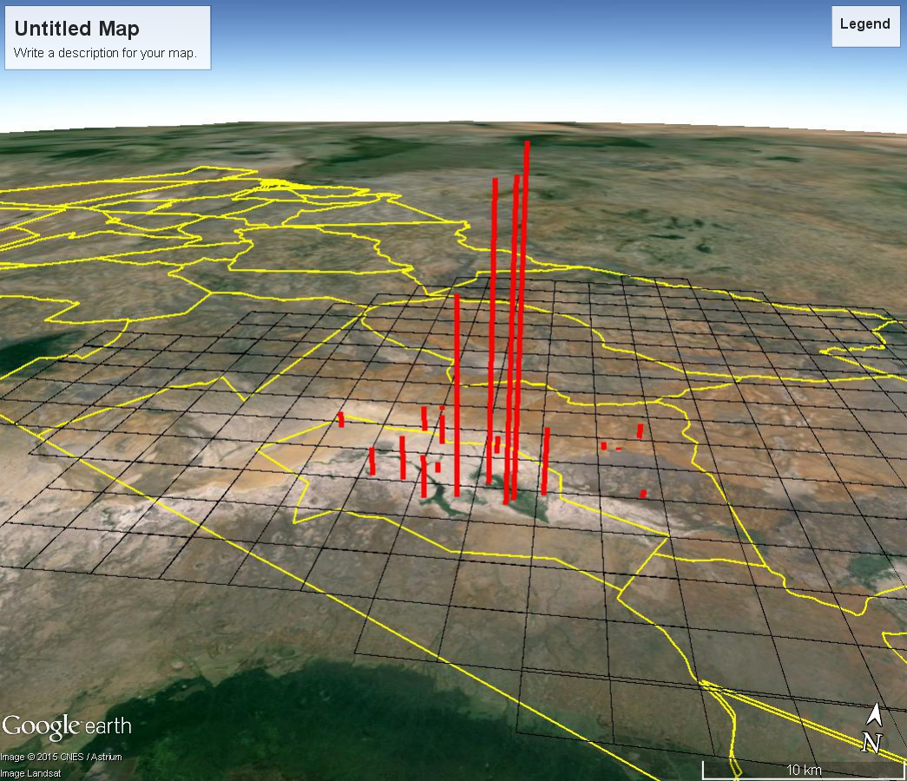

Slide 13
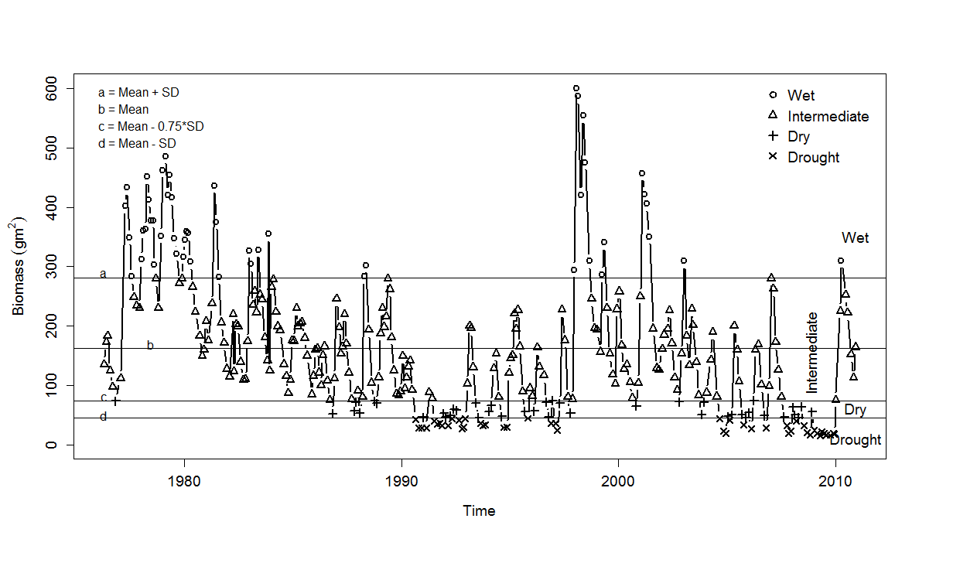
MONTHLY PASTURE BIOMASS OF AMBOSELI ECOSYSTEM

Slide 14
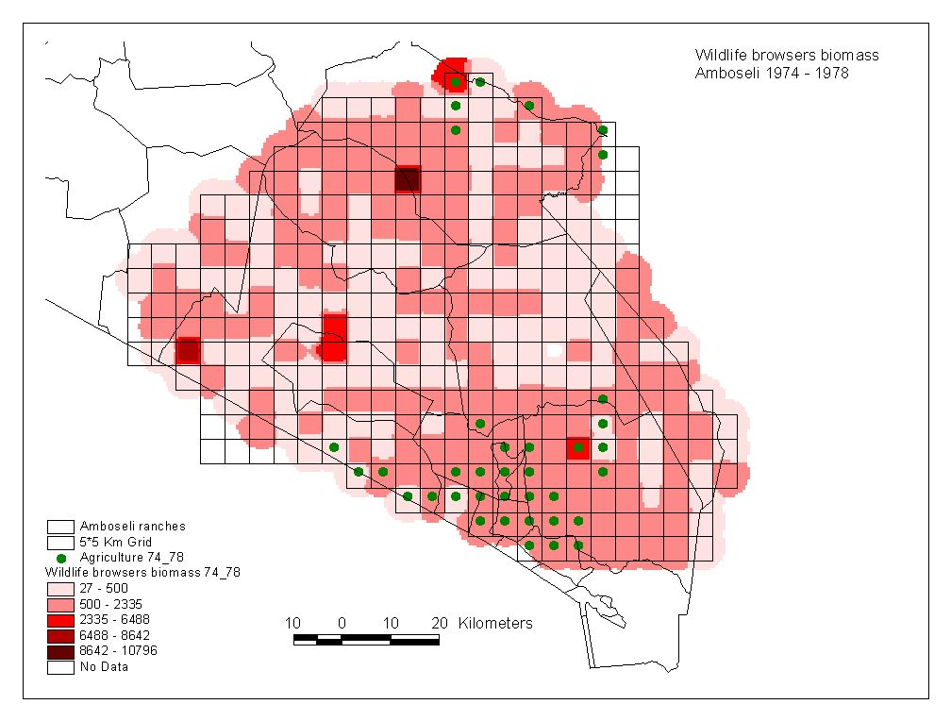
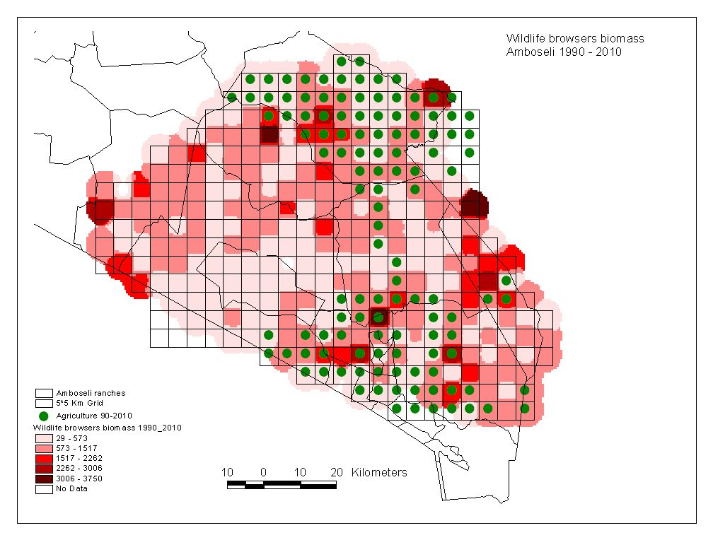
FARM AND SETTLEMENT DISTRIBUTION (1970s-2000s)

Slide 15
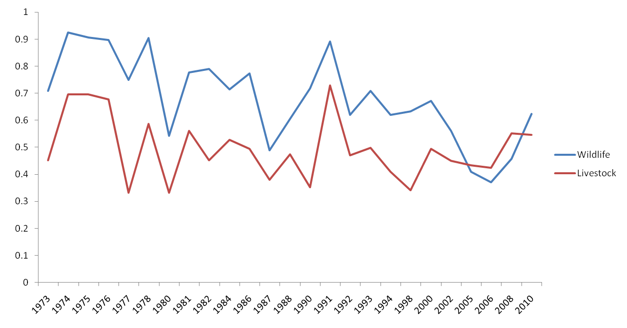
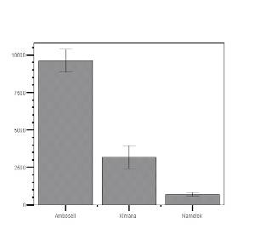
Settlement Spread
Proportion of Grids with Livestock and Wildlife
Wildlife Biomass Density (kg/km²)
Notes:
Spatial distribution
trends
- community structure

Slide 16
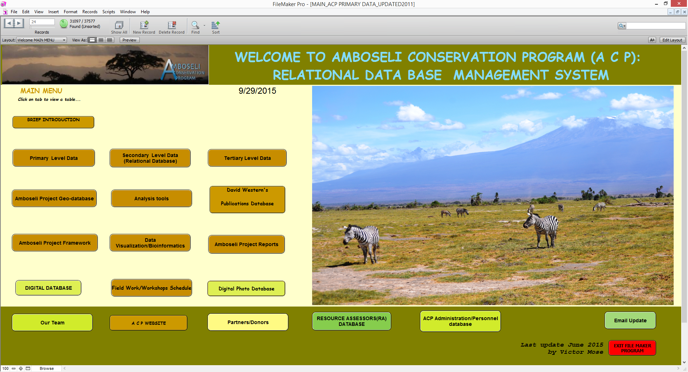
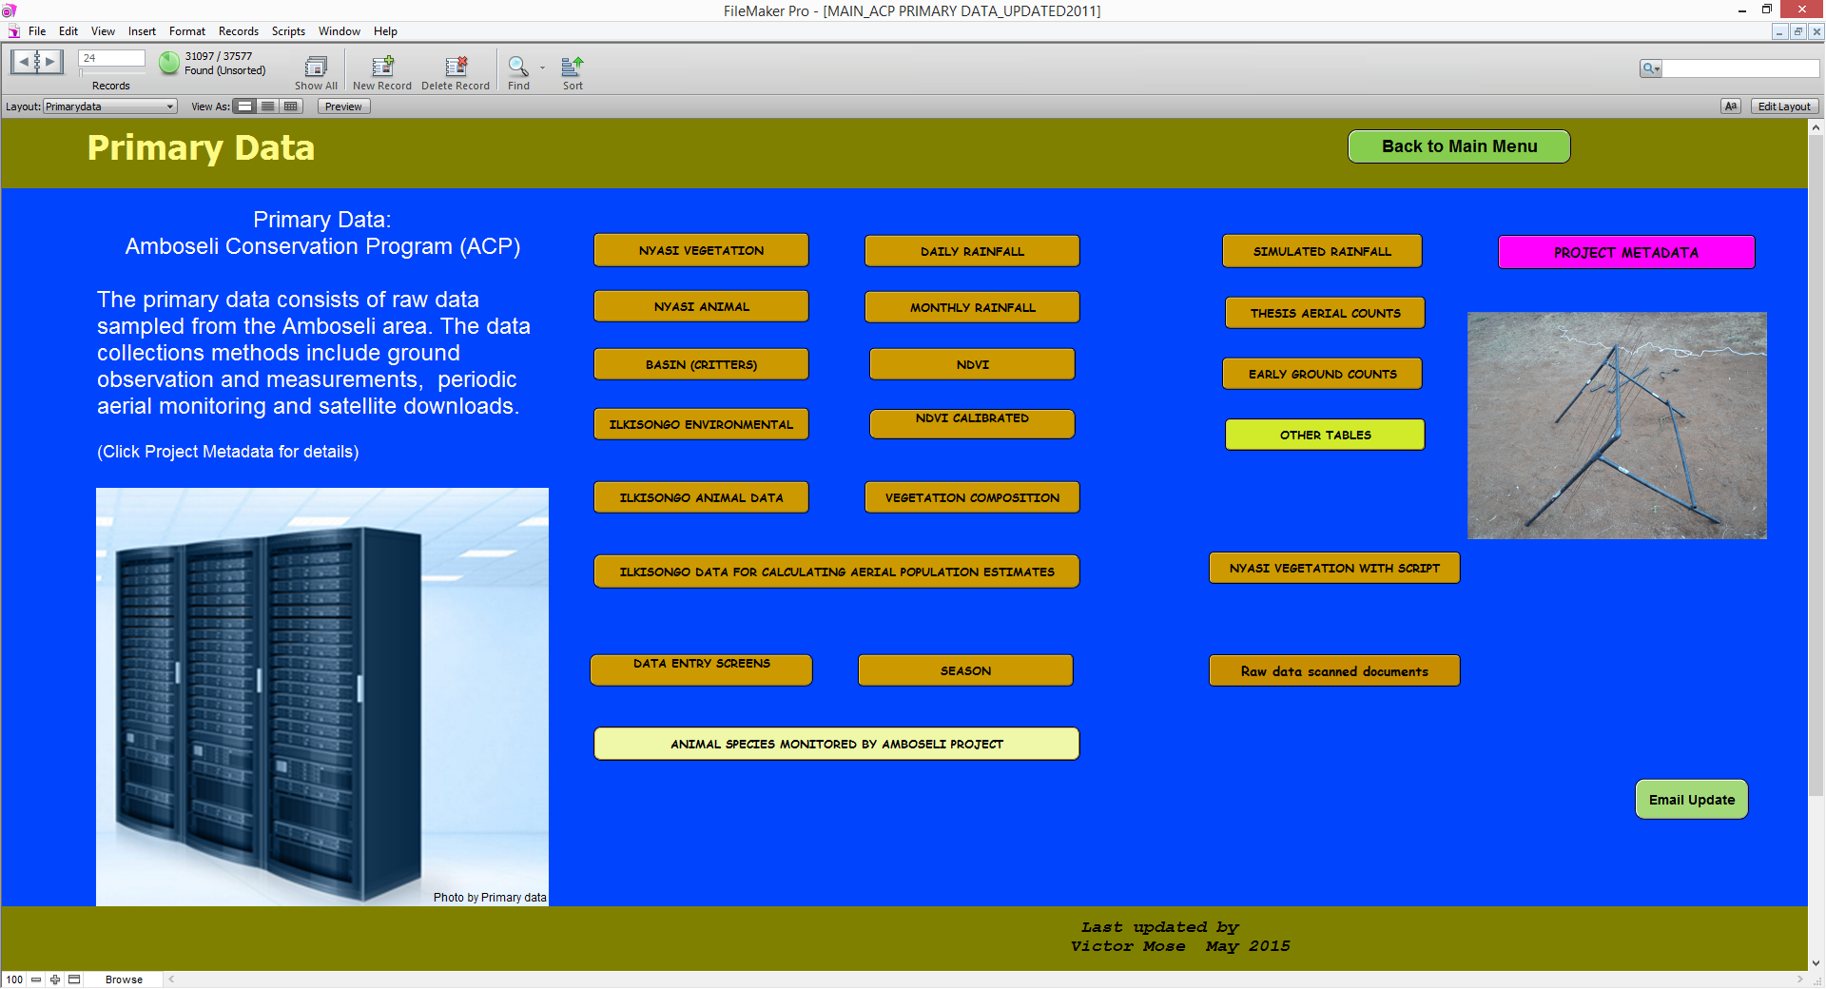

Slide 17
CAUSES OF ECOLOGICAL DECLINE
Dry land farming
Wetland irrigated farming
Sedentarization
Segregation effects of land use
Habitat change
Loss of drought refuges
Loss of rangeland productivity and recovery
Rising drought frequency and intensity
Illegal harvest of animals and plants

Slide 18
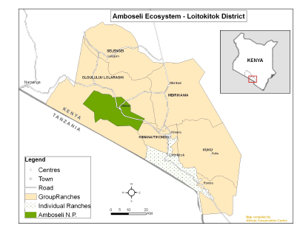
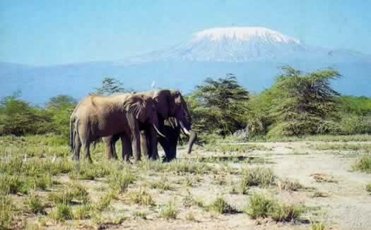
AMBOSELI ECOSYSTEM MANAGEMENT PLAN
2009 – 2018

Slide 19
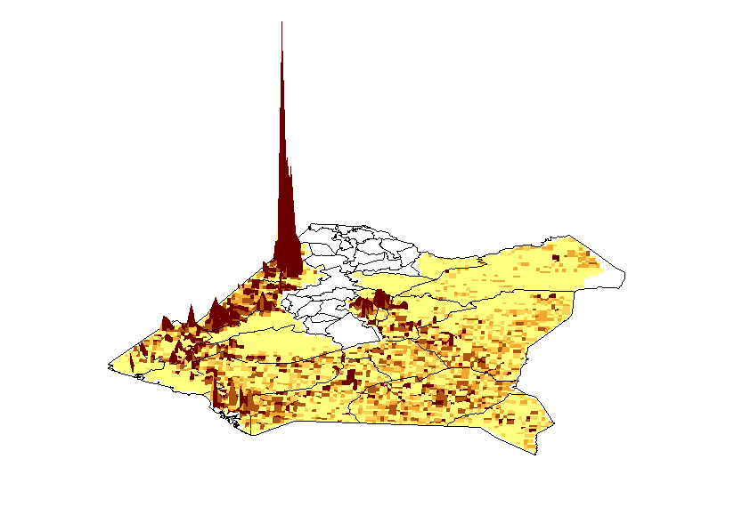
If we were to turn wildlife into skyscrapers where will they be located?

Slide 20
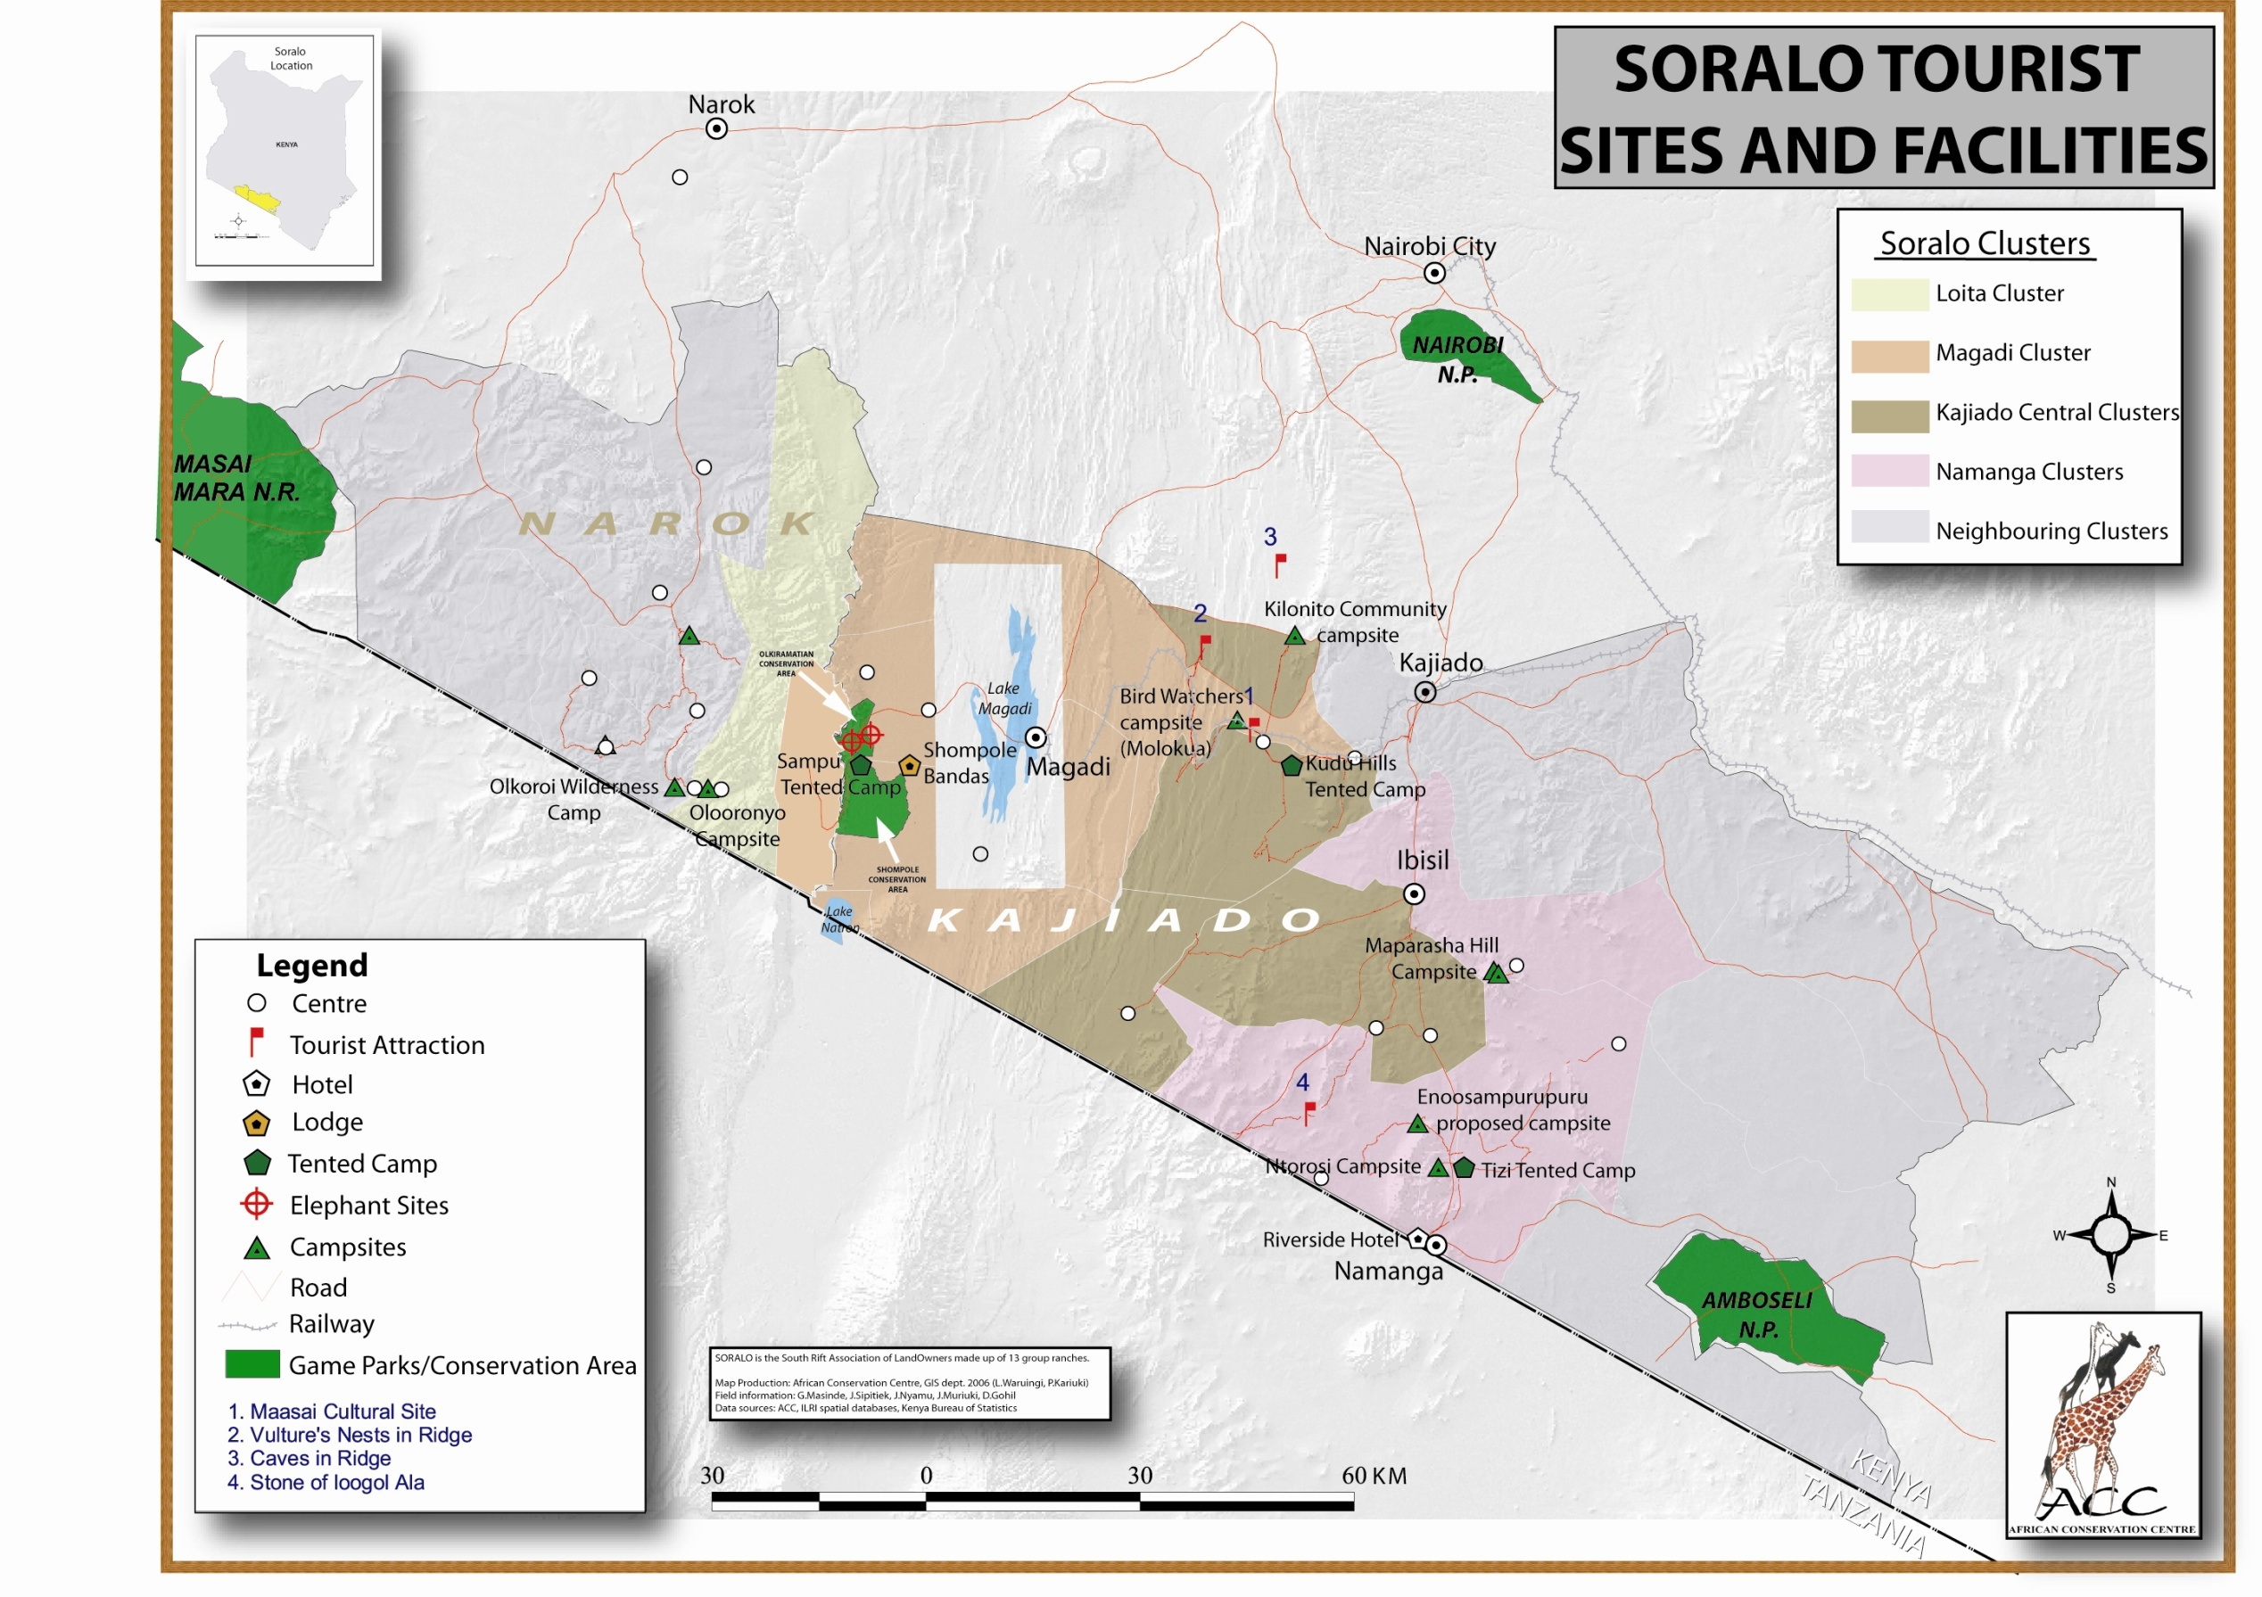

Slide 21
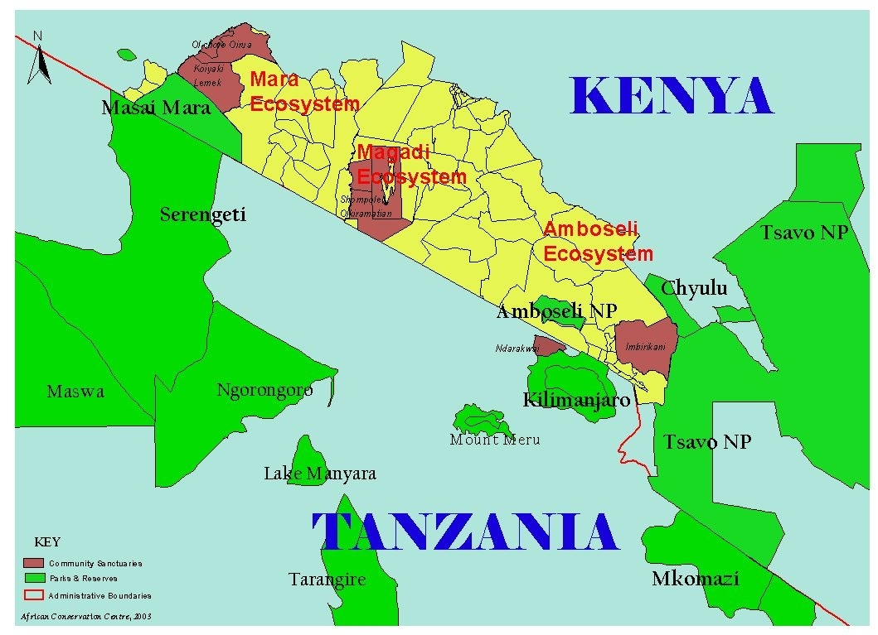

Slide 22
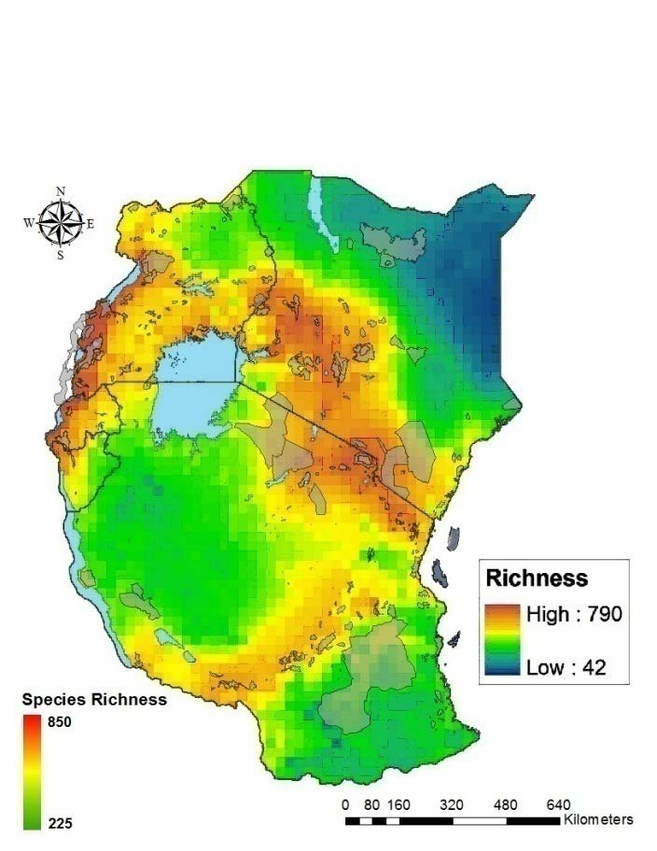
EAST AFRICA
RICH BIODIVERSTIY – ALONG A HIGH ALTITUDE GRADIENT

Slide 23
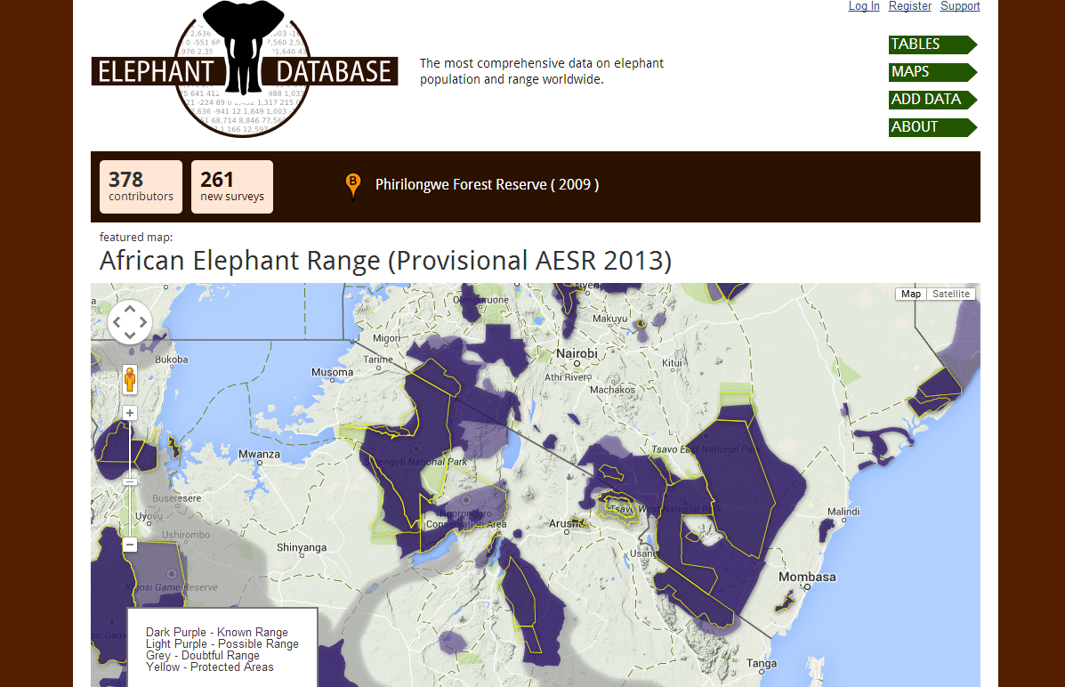

Slide 24
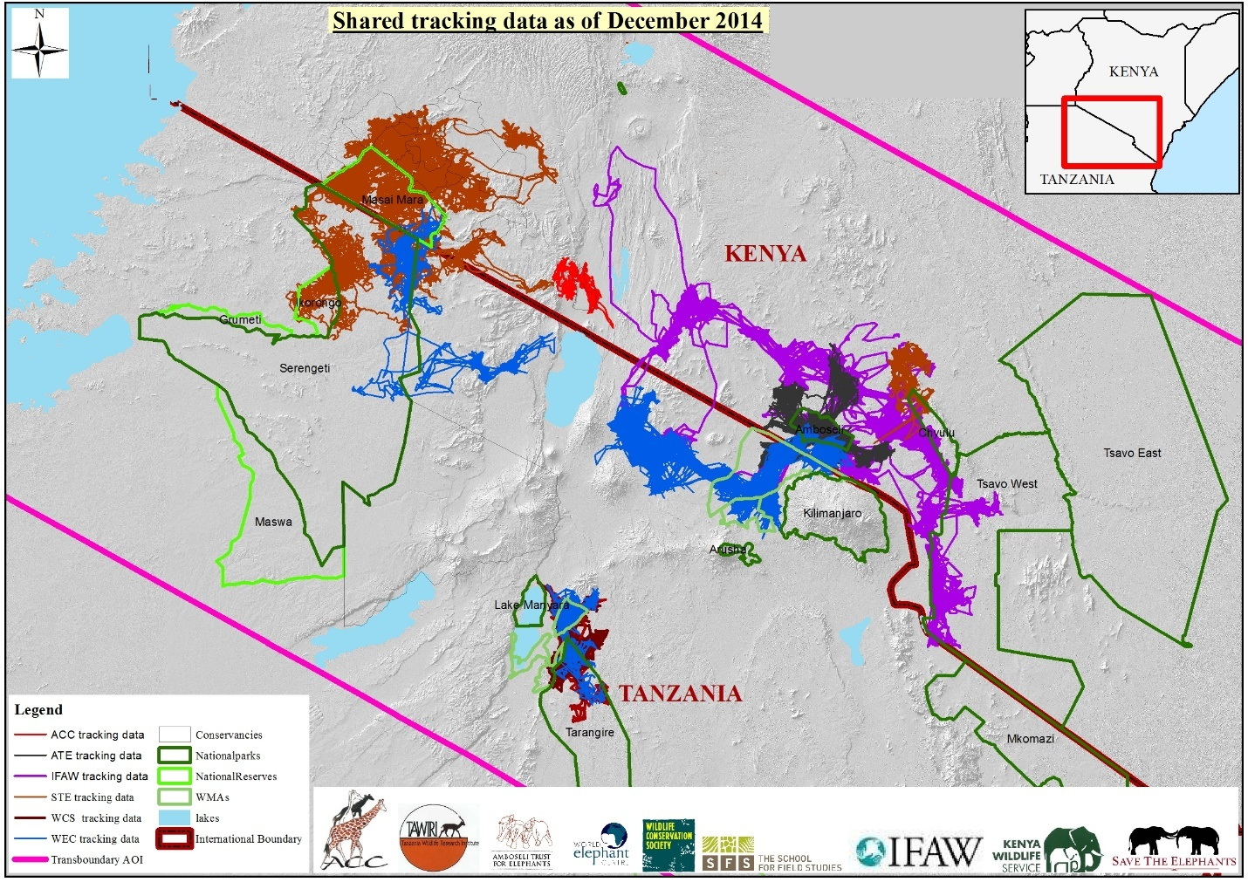

Slide 25
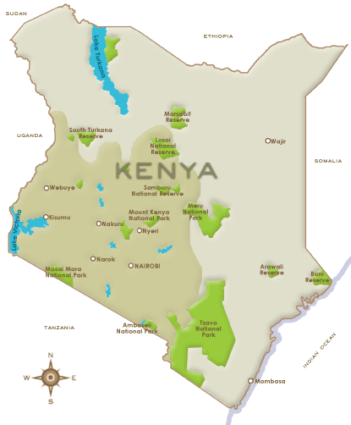
Kenya has a large diversity of ecological zones and habitats, including lowland and mountain forests, wooded and open grasslands, semi-arid scrubland, dry woodlands, inland aquatic, as well as coastal and marine ecosystems.
Kenya has 59 parks/reserves occupying 8% of land area
Over 70% of Kenya’s Biodiversity is found outside these protected areas and conservation of these hotspots is critical
Kenya now has between 200-250 community and private conservancies engaged in Voluntary Environmental Management – the new constitution 2010 recognizes this as a form of landuse

Slide 26
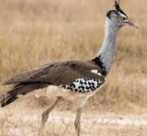
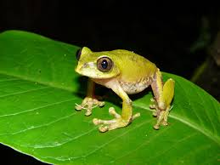
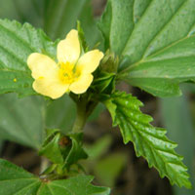
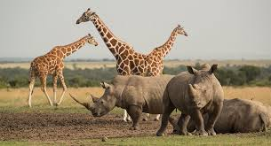
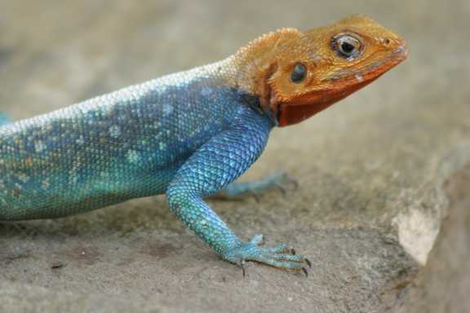

BIODIVERSITY AND CLIMATE CHANGE
2010 International Conference on Biodiversity, Landuse and Climate Change (Govt, NGOs, Various donors & JRS)
Assessment of vulnerability of Biodiversity to Climate Change (NASA Servir Africa Project)

Slide 29
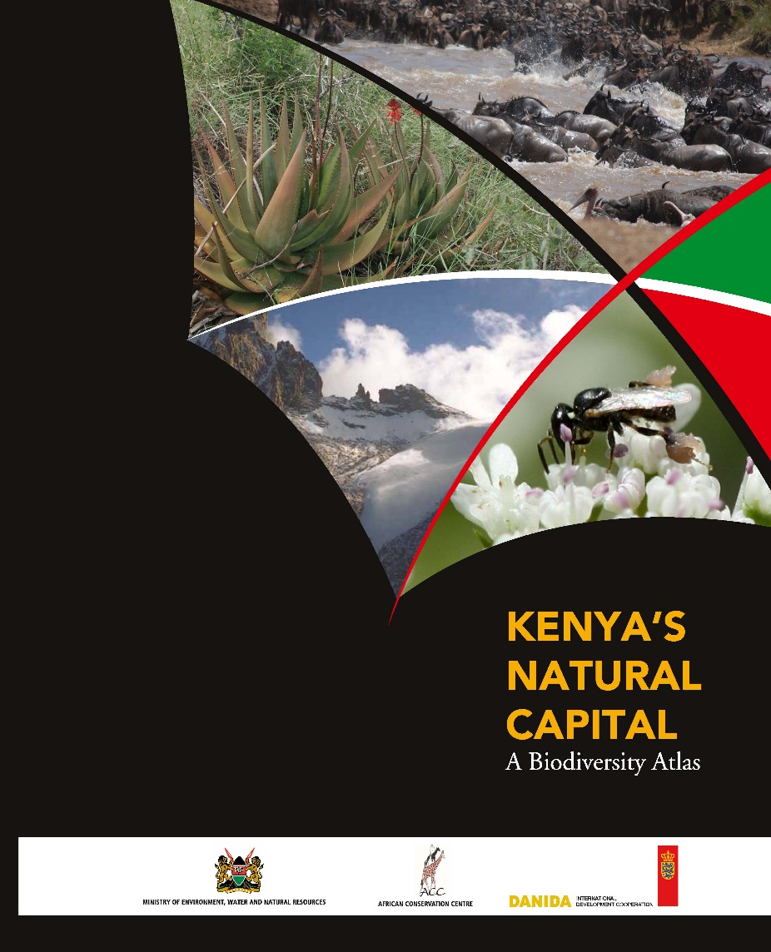
KENYA’S NATURAL CAPITAL: A BIODIVERISITY ATLAS
2012 – 2014: A consortium of 15 agenices in collaboration with the Ministry of Environment compiled the 1st Biodiversity Atlas for KENYA. Atlas details the status, trends and threats of various taxonomic groups in Kenya.
150 Page illustrative Atlas with an accompanying 800 page compendium [Atlas to be launched in 2015]

Slide 30
BIODIVERSITY ATLAS RECOMMENDATIONS
Atlas makes five (5) Policy recommendations for development of framework for the auditing and accounting of Kenya’s Natural capital
There is need for regular Mapping and Quantifying biodiversity and ecosystem services in support of sustainable development

Slide 31
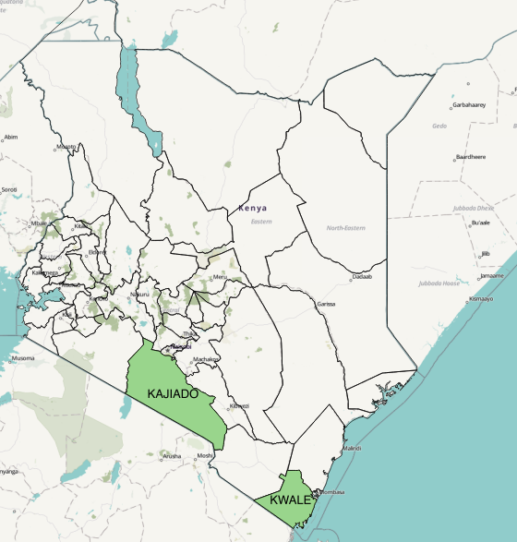
WEB-PORTAL, DECISION SUPPORT TOOLS
2015 - Spatial planning for Flora and Fauna
Developing a web-portal for Biodiversity decision making at county level
Pilot counties: KAJIADO and KWALE. Richest in Flora and Fauna

Slide 32
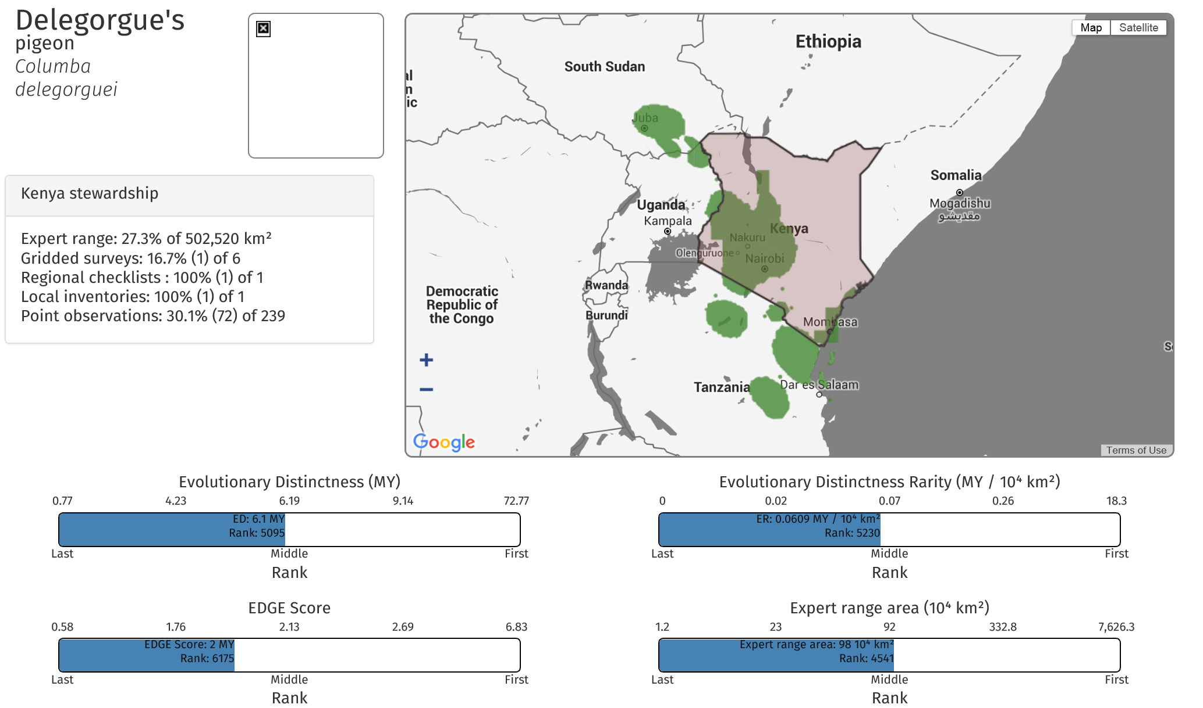

Slide 33
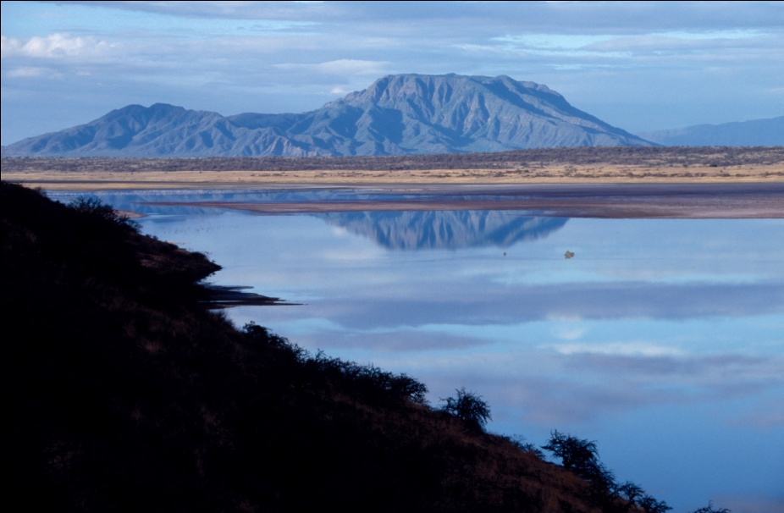
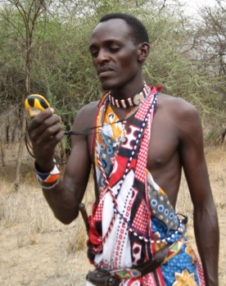
FROM THE GROUND UP…
Develop actual use-cases for the biodiversity data holdings - SHOW
Pilot smaller application projects to build credible partnerships, capacity, confidence and buy-in. Then scale up in scope and space - SHARPEN
Develop robust interoperable data collection, management and analytical tools that can be replicated - SHARE
  Shompole Hill, overlooking lake Magadi
  Community Resource Assessor collecting data

Slide 34
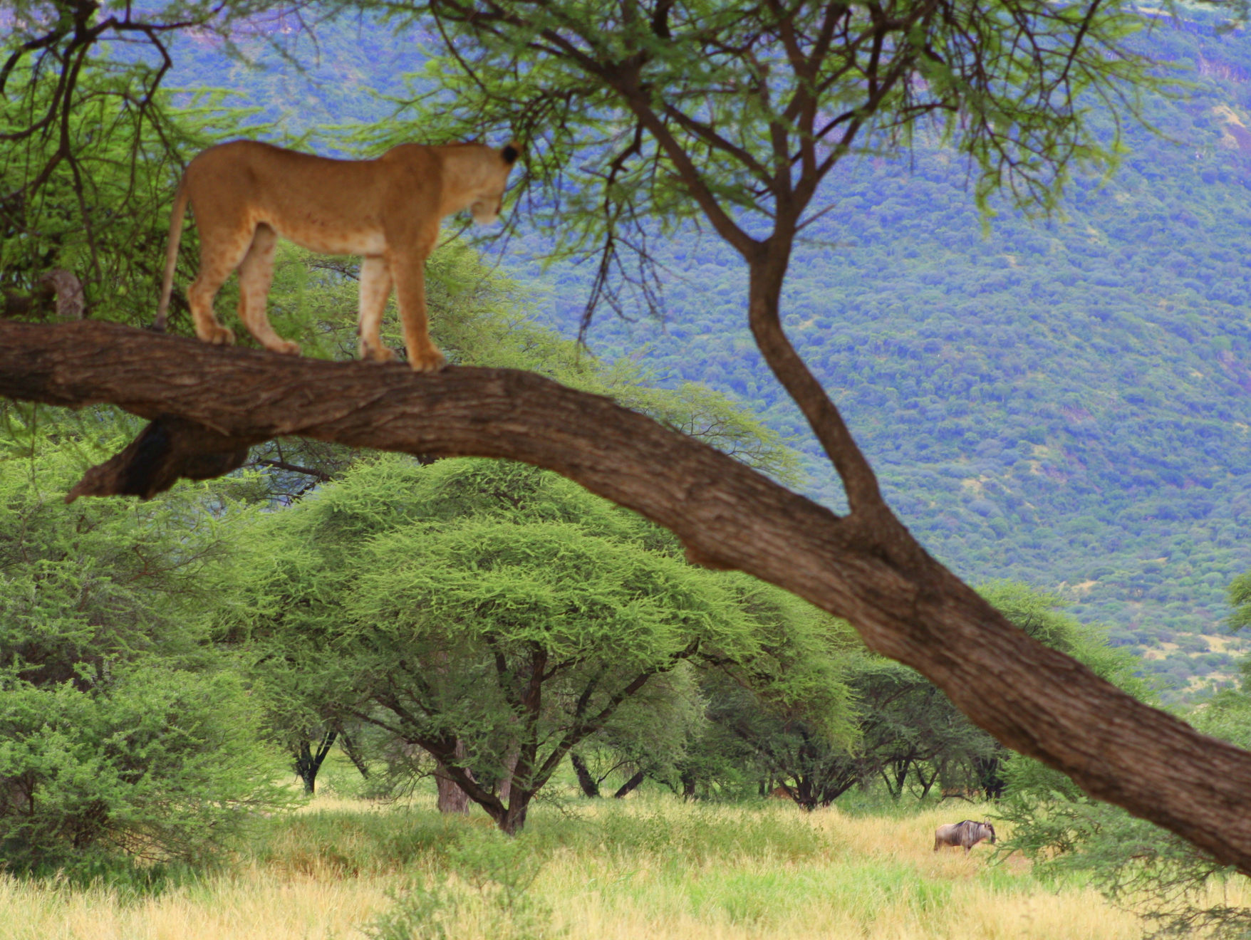
THANK YOU
African Conservation Centre
PO Box 15289-00509
Nairobi, KENYA
URL: www.conservationafrica.org
Email: lucy.waruingi@acc.or.ke

